Slide 1


NON-WSQ COURSE • 1 DAY
CYBER SECURITY
AWARENESS
Workshop
Recognise threats. Reduce exposure. Escalate with confidence.
C506
Tertiary Infotech Academy Pte Ltd
UEN 201200696W
C506 | v1.0

Slide 2
COURSE ORIENTATION
Welcome to the course
Recognise
Reduce
Escalate
Spot threat patterns, vulnerable conditions and signs that deserve attention.
Apply layered safeguards that protect people, devices, data and business processes.
Communicate evidence, impact and urgency to the right person without making the incident worse.
C506 | v1.0

Slide 3
1 DAY • 7.5 HOURS
The day at a glance
1
Threats
2
Exposure
3
Safeguards
4
Response
5
Action
Language, attack chains and warning signs
Assets, vulnerabilities and business risk
Identity, devices, data, network and people
Evidence, containment and escalation
Key takeaways and a 30-day action plan
Concepts on slides • detailed procedures in the Learner Guide
C506 | v1.0

Slide 4
AUTHORISATION FIRST
A safe learning environment
DO
DO NOT
✓
Use only supplied mock data
✓
Test real organisations
✓
Stay inside named training sites
✓
Enter real passwords or personal data
✓
Preserve evidence and privacy
✓
Attempt denial of service
✓
Stop when scope is uncertain
✓
Publish exploitable findings
C506 | v1.0

Slide 5
THE CIA TRIAD — PLUS BUSINESS CONSEQUENCES
Cybersecurity is a business capability
Confidentiality
Integrity
Availability
Safety & trust
Only authorised people and systems access information.
Information and processes remain accurate, complete and trustworthy.
Services and data are accessible when the business needs them.
Digital failures can affect people, operations, money and reputation.
C506 | v1.0
Source: https://www.ibm.com/think/topics/cybersecurity

Slide 6
CORE MODEL
How a cyber incident unfolds
1
Asset
2
Threat
3
Vulnerability
4
Exploit
5
Impact
Something valuable: identity, device, data, service or money
A person, event or mechanism capable of harm
A weakness or unsafe condition
A technique that takes advantage of the weakness
Loss to confidentiality, integrity, availability or trust
Risk grows when valuable assets, credible threats and exploitable weaknesses meet.
C506 | v1.0
Source: https://www.ncsc.gov.uk/collection/vulnerability-management/understanding-vulnerabilities

Slide 7
RISK THINKING
Risk is a decision, not just a score
Likelihood
Impact
Control strength
How plausible is exploitation in this context? Consider reachability, capability and active exploitation.
What happens to people, operations, finance, compliance and reputation?
Does a safeguard prevent, detect, contain or recover — and has it been verified?
C506 | v1.0

Slide 8
EDITABLE DATA VIEW
Business email compromise cases edged upward
READ THE SIGNAL
Singapore Police recorded 377 BEC cases in 2025, up from 368 in 2024. Small changes in volume still represent repeated opportunities for high-impact loss.
Chart is native and editable in PowerPoint.
C506 | v1.0
Source: https://www.police.gov.sg/-/media/SPF/Media-Room/Statistics/Annual-Scams-and-Cybercrime-Brief-2025/Ann…

Slide 9
EDITABLE DATA VIEW
BEC losses fell — but remained material
READ THE SIGNAL
Reported losses fell, yet S$35.3 million remained at stake. Independent verification and rapid escalation change outcomes.
Chart is native and editable in PowerPoint.
C506 | v1.0
Source: https://www.police.gov.sg/-/media/SPF/Media-Room/Statistics/Annual-Scams-and-Cybercrime-Brief-2025/Ann…

Slide 10
ONE DIGITAL LIFE • MANY DEPENDENCIES
Personal and business risk are connected
Personal account
Work identity
Business process
Shared consequence
A reused password unlocks email; email resets other accounts.
A personal device or inbox becomes a path into business systems.
A believable message changes payment, access or recovery decisions.
Money, data, services and trust are affected across both worlds.
C506 | v1.0

Slide 11
01
Identify cyber risks and threats
TOPIC
Read behaviours, attack paths and warning signs before deciding what to do.
SEE
DECIDE
ACT
C506 | v1.0

Slide 12
WHO • WHY • HOW
Threat actors pursue different goals
Cybercriminal
Insider
Hacktivist
Money through theft, extortion, fraud or resale.
Malicious, coerced or accidental misuse of legitimate access.
Disruption or disclosure to advance a cause.
Nation-state / APT
Opportunist
Supplier compromise
Strategic intelligence, influence or critical-infrastructure access.
Scans widely for exposed or unpatched systems.
Abuses trusted software, services or relationships.
C506 | v1.0

Slide 13
THINK IN SEQUENCES
Attack chain: from initial access to impact
1
Initial access
2
Execution
3
Persistence
4
Expansion
5
Impact
Phishing, exposed service, stolen credentials or supplier
Malicious code, command or abused legitimate tool
Account, scheduled task, service or modified application
Privilege escalation, discovery and lateral movement
Theft, fraud, encryption, disruption or manipulation
Break one link early and the whole outcome can change.
C506 | v1.0

Slide 14
TYPES AND CHARACTERISTICS
Malware families: behaviour matters
Virus
Worm
Trojan
Ransomware
Attaches to a host file and executes when the file runs
Self-propagates across reachable systems
Disguises malicious capability as legitimate software
Encrypts or disrupts systems and demands payment
Spyware
Rootkit
Bot
Logic bomb
Collects activity, credentials or data covertly
Hides privileged malicious activity
Places a device under remote command
Triggers a malicious action when a condition is met
Adware
Keylogger
Fileless malware
Cryptojacker
Displays intrusive advertising and may track browsing or alter settings
Records keystrokes to capture credentials and sensitive input
Abuses memory and legitimate administration tools instead of relying on a normal file
Hijacks computing resources to mine cryptocurrency
C506 | v1.0
Source: https://www.crowdstrike.com/en-us/cybersecurity-101/malware/types-of-malware/

Slide 15
OBSERVABLE SIGNALS
Malware warning signs
Virus
Worm
Trojan
Ransomware
Unexpected file changes; antivirus detections
Rapid scanning and repeated connections
Untrusted installer, new process or persistence
File extensions change, ransom note, unavailable services
Spyware
Rootkit
Bot
Logic bomb
Browser changes, unusual outbound traffic
Integrity anomalies, unexplained privileged changes
Beaconing, DDoS or spam activity
Scheduled or conditional destructive code
Adware
Keylogger
Fileless malware
Cryptojacker
Persistent pop-ups, redirects and unwanted extensions
Unexplained input hooks, suspicious processes or credential theft
Unexpected PowerShell, script hosts, encoded commands or memory activity
High CPU or cloud cost, overheating and unknown mining connections
C506 | v1.0
Source: https://www.crowdstrike.com/en-us/cybersecurity-101/malware/types-of-malware/

Slide 16
MALWARE DISTINCTIONS
Virus, worm and trojan are not interchangeable
PROPAGATION
DEFENSIVE LENS
✓
Virus needs a host and user execution
✓
Control execution
✓
Worm self-propagates across reachable systems
✓
Patch and segment
✓
Trojan relies on disguise and user trust
✓
Use trusted software sources
✓
All may deliver additional payloads
✓
Monitor behaviour, not only filenames
C506 | v1.0
Source: https://www.crowdstrike.com/en-us/cybersecurity-101/malware/types-of-malware/

Slide 17
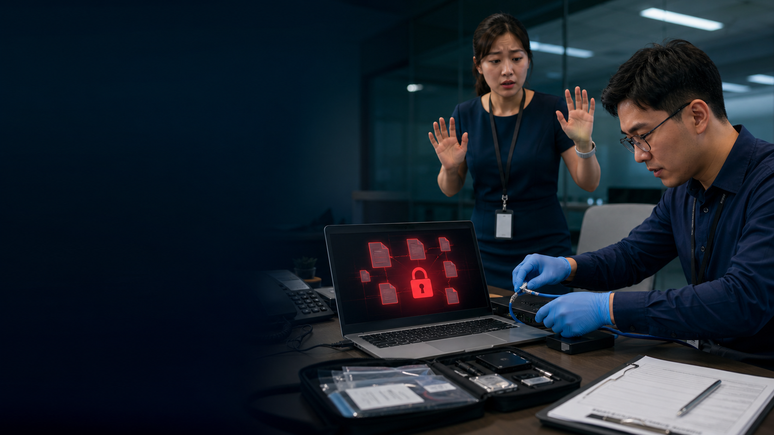
MALWARE TYPE 01 OF 12
Virus: behaviour, evidence and response
1
CORE BEHAVIOUR
Attaches to a host file and executes when the file runs
2
WATCH FOR
Unexpected file changes; antivirus detections
3
BUSINESS EFFECT + FIRST PRIORITY
Corrupts files and uses human execution to continue spreading. Block execution, isolate, restore clean copies.
Classify from multiple signals; isolate safely and preserve evidence before making destructive changes.
C506 | v1.0
Source: https://www.crowdstrike.com/en-us/cybersecurity-101/malware/types-of-malware/

Slide 18

MALWARE TYPE 02 OF 12
Worm: behaviour, evidence and response
1
CORE BEHAVIOUR
Self-propagates across reachable systems
2
WATCH FOR
Rapid scanning and repeated connections
3
BUSINESS EFFECT + FIRST PRIORITY
Consumes network capacity and compromises many reachable systems quickly. Segment, patch, isolate affected segments.
Classify from multiple signals; isolate safely and preserve evidence before making destructive changes.
C506 | v1.0
Source: https://www.crowdstrike.com/en-us/cybersecurity-101/malware/types-of-malware/

Slide 19
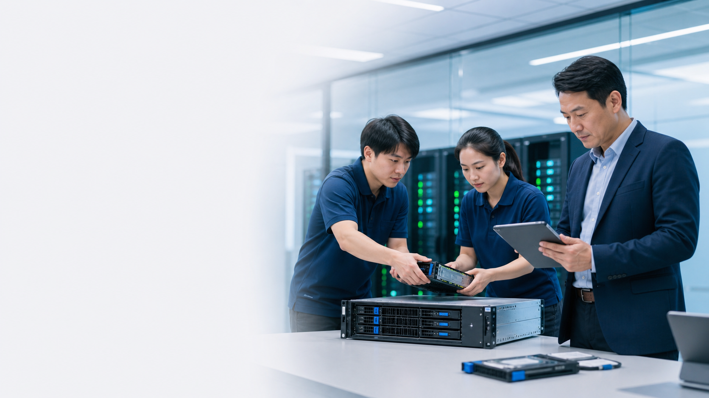
MALWARE TYPE 03 OF 12
Trojan: behaviour, evidence and response
1
CORE BEHAVIOUR
Disguises malicious capability as legitimate software
2
WATCH FOR
Untrusted installer, new process or persistence
3
BUSINESS EFFECT + FIRST PRIORITY
Creates trusted-looking access for theft, persistence or a second payload. Application control, trusted sources, EDR.
Classify from multiple signals; isolate safely and preserve evidence before making destructive changes.
C506 | v1.0
Source: https://www.crowdstrike.com/en-us/cybersecurity-101/malware/types-of-malware/

Slide 20
MALWARE TYPE 04 OF 12
Ransomware: behaviour, evidence and response
1
CORE BEHAVIOUR
Encrypts or disrupts systems and demands payment
2
WATCH FOR
File extensions change, ransom note, unavailable services
3
BUSINESS EFFECT + FIRST PRIORITY
Stops operations, threatens disclosure and forces time-critical recovery decisions. Isolate, preserve evidence, activate response and recovery.
Classify from multiple signals; isolate safely and preserve evidence before making destructive changes.
C506 | v1.0
Source: https://www.crowdstrike.com/en-us/cybersecurity-101/malware/types-of-malware/

Slide 21
MALWARE TYPE 05 OF 12
Spyware: behaviour, evidence and response
1
CORE BEHAVIOUR
Collects activity, credentials or data covertly
2
WATCH FOR
Browser changes, unusual outbound traffic
3
BUSINESS EFFECT + FIRST PRIORITY
Steals activity, credentials and sensitive information while remaining quiet. Remove persistence, reset credentials safely.
Classify from multiple signals; isolate safely and preserve evidence before making destructive changes.
C506 | v1.0
Source: https://www.crowdstrike.com/en-us/cybersecurity-101/malware/types-of-malware/

Slide 22
MALWARE TYPE 06 OF 12
Rootkit: behaviour, evidence and response
1
CORE BEHAVIOUR
Hides privileged malicious activity
2
WATCH FOR
Integrity anomalies, unexplained privileged changes
3
BUSINESS EFFECT + FIRST PRIORITY
Undermines trust in the operating system and can hide privileged activity. Offline investigation, rebuild trusted baseline.
Classify from multiple signals; isolate safely and preserve evidence before making destructive changes.
C506 | v1.0
Source: https://www.crowdstrike.com/en-us/cybersecurity-101/malware/types-of-malware/

Slide 23
MALWARE TYPE 07 OF 12
Bot: behaviour, evidence and response
1
CORE BEHAVIOUR
Places a device under remote command
2
WATCH FOR
Beaconing, DDoS or spam activity
3
BUSINESS EFFECT + FIRST PRIORITY
Turns the device into remotely controlled infrastructure for spam, fraud or DDoS. Block command-and-control, isolate, remediate.
Classify from multiple signals; isolate safely and preserve evidence before making destructive changes.
C506 | v1.0
Source: https://www.crowdstrike.com/en-us/cybersecurity-101/malware/types-of-malware/

Slide 24
MALWARE TYPE 08 OF 12
Logic bomb: behaviour, evidence and response
1
CORE BEHAVIOUR
Triggers a malicious action when a condition is met
2
WATCH FOR
Scheduled or conditional destructive code
3
BUSINESS EFFECT + FIRST PRIORITY
Creates delayed or conditional sabotage that may resemble an ordinary failure. Code review, least privilege, change control.
Classify from multiple signals; isolate safely and preserve evidence before making destructive changes.
C506 | v1.0
Source: https://www.crowdstrike.com/en-us/cybersecurity-101/malware/types-of-malware/

Slide 25
MALWARE TYPE 09 OF 12
Adware: behaviour, evidence and response
1
CORE BEHAVIOUR
Displays intrusive advertising and may track browsing or alter settings
2
WATCH FOR
Persistent pop-ups, redirects and unwanted extensions
3
BUSINESS EFFECT + FIRST PRIORITY
Degrades user trust and may introduce tracking, redirects or further unwanted software. Remove unwanted software, review permissions, use trusted sources.
Classify from multiple signals; isolate safely and preserve evidence before making destructive changes.
C506 | v1.0
Source: https://www.crowdstrike.com/en-us/cybersecurity-101/malware/types-of-malware/

Slide 26
MALWARE TYPE 10 OF 12
Keylogger: behaviour, evidence and response
1
CORE BEHAVIOUR
Records keystrokes to capture credentials and sensitive input
2
WATCH FOR
Unexplained input hooks, suspicious processes or credential theft
3
BUSINESS EFFECT + FIRST PRIORITY
Captures secrets at entry, potentially bypassing strong password complexity. Endpoint protection, MFA, safe rebuild and credential reset.
Classify from multiple signals; isolate safely and preserve evidence before making destructive changes.
C506 | v1.0
Source: https://www.crowdstrike.com/en-us/cybersecurity-101/malware/types-of-malware/

Slide 27
MALWARE TYPE 11 OF 12
Fileless malware: behaviour, evidence and response
1
CORE BEHAVIOUR
Abuses memory and legitimate administration tools instead of relying on a normal file
2
WATCH FOR
Unexpected PowerShell, script hosts, encoded commands or memory activity
3
BUSINESS EFFECT + FIRST PRIORITY
Blends into legitimate administration activity and reduces reliance on obvious files. Restrict scripting, monitor behaviour, least privilege, EDR.
Classify from multiple signals; isolate safely and preserve evidence before making destructive changes.
C506 | v1.0
Source: https://www.crowdstrike.com/en-us/cybersecurity-101/malware/types-of-malware/

Slide 28
MALWARE TYPE 12 OF 12
Cryptojacker: behaviour, evidence and response
1
CORE BEHAVIOUR
Hijacks computing resources to mine cryptocurrency
2
WATCH FOR
High CPU or cloud cost, overheating and unknown mining connections
3
BUSINESS EFFECT + FIRST PRIORITY
Consumes compute capacity and cloud budget while masking the attack as poor performance. Patch entry points, control scripts, monitor resource use and cloud spend.
Classify from multiple signals; isolate safely and preserve evidence before making destructive changes.
C506 | v1.0
Source: https://www.crowdstrike.com/en-us/cybersecurity-101/malware/types-of-malware/

Slide 29
PREVENT • DETECT • RECOVER
Ransomware is an operational event
Prepare
Detect
Respond
Asset inventory, supported systems, least privilege, segmented access and tested offline backups.
Mass file changes, disabled security tools, unusual admin activity, lateral movement and ransom notes.
Isolate safely, preserve evidence, activate the incident team, assess scope and recover from trusted sources.
C506 | v1.0

Slide 30
PAUSE WHEN EMOTION RISES
Social engineering targets decisions
Authority
Urgency
Fear
‘The CEO has approved this.’
‘Pay in the next ten minutes.’
‘Your account will be closed.’
Scarcity
Familiarity
Secrecy
‘Only three places remain.’
‘I am your supplier / colleague.’
‘Do not tell anyone yet.’
C506 | v1.0

Slide 31

SOCIAL ENGINEERING 01 OF 16
Phishing: see it in everyday life
1
WHAT IT CAN LOOK LIKE
‘Your parcel is waiting. Pay S$1.20 at parcel-status.example.test within 30 minutes.’
2
SPOT THESE CLUES
Generic urgency, mismatched link, unexpected attachment
3
DO THIS INSTEAD
Use a known route to the service; report the message
How it works: Broad deceptive email seeks clicks, credentials, payments or malware execution
C506 | v1.0
Source: https://www.police.gov.sg/-/media/SPF/Media-Room/Statistics/Annual-Scams-and-Cybercrime-Brief-2025/Ann…

Slide 32
SOCIAL ENGINEERING 02 OF 16
Spear phishing: see it in everyday life
1
WHAT IT CAN LOOK LIKE
‘Hi Mei, I saw your Project Atlas post. Open the attached revised budget before today's client call.’
2
SPOT THESE CLUES
Accurate context paired with an unusual request or channel
3
DO THIS INSTEAD
Verify the request with the known person using another channel
How it works: A tailored message uses role, project or relationship details to appear credible
C506 | v1.0
Source: https://www.police.gov.sg/-/media/SPF/Media-Room/Statistics/Annual-Scams-and-Cybercrime-Brief-2025/Ann…

Slide 33
SOCIAL ENGINEERING 03 OF 16
Whaling: see it in everyday life
1
WHAT IT CAN LOOK LIKE
‘The chairman needs the confidential acquisition file now. Send it to this private address and do not copy anyone.’
2
SPOT THESE CLUES
Legal, finance or board urgency; secrecy; authority pressure
3
DO THIS INSTEAD
Executive verification protocol and delegated dual approval
How it works: A high-value executive or decision-maker is specifically targeted
C506 | v1.0
Source: https://www.police.gov.sg/-/media/SPF/Media-Room/Statistics/Annual-Scams-and-Cybercrime-Brief-2025/Ann…

Slide 34
SOCIAL ENGINEERING 04 OF 16
Business email compromise: see it in everyday life
1
WHAT IT CAN LOOK LIKE
‘We changed banks. Pay invoice INV-2048 to the new account today; reply only to this email.’
2
SPOT THESE CLUES
New bank details, lookalike domain, altered reply-to or unusual timing
3
DO THIS INSTEAD
Independent call-back using stored contacts; dual approval
How it works: An attacker impersonates or takes over a trusted mailbox to change a business transaction
C506 | v1.0
Source: https://www.police.gov.sg/-/media/SPF/Media-Room/Statistics/Annual-Scams-and-Cybercrime-Brief-2025/Ann…

Slide 35
SOCIAL ENGINEERING 05 OF 16
Smishing: see it in everyday life
1
WHAT IT CAN LOOK LIKE
‘Bank alert: your account is locked. Tap bank-verify.example.test now.’
2
SPOT THESE CLUES
Delivery, bank or government lure with shortened link and urgency
3
DO THIS INSTEAD
Open the official app or known website instead of the message link
How it works: SMS or messaging platforms deliver fraudulent links, codes or support requests
C506 | v1.0
Source: https://www.police.gov.sg/-/media/SPF/Media-Room/Statistics/Annual-Scams-and-Cybercrime-Brief-2025/Ann…

Slide 36

SOCIAL ENGINEERING 06 OF 16
Vishing: see it in everyday life
1
WHAT IT CAN LOOK LIKE
‘I'm from the bank fraud team. Read me the six-digit code so I can cancel the transfer.’
2
SPOT THESE CLUES
Caller pressure, request for codes, remote access or immediate payment
3
DO THIS INSTEAD
End the call and dial a known official number
How it works: A caller impersonates authority, support, a bank or a colleague to obtain action or secrets
C506 | v1.0
Source: https://www.police.gov.sg/-/media/SPF/Media-Room/Statistics/Annual-Scams-and-Cybercrime-Brief-2025/Ann…

Slide 37
SOCIAL ENGINEERING 07 OF 16
QR phishing / quishing: see it in everyday life
1
WHAT IT CAN LOOK LIKE
A parking notice says ‘Scan to avoid a fine’, but the QR destination is pay-parking.example.test.
2
SPOT THESE CLUES
Unsolicited QR code near payment, login, parking or document access
3
DO THIS INSTEAD
Preview the destination; use a known app or typed address
How it works: A QR code hides the destination and moves the victim onto a mobile browser
C506 | v1.0
Source: https://www.police.gov.sg/-/media/SPF/Media-Room/Statistics/Annual-Scams-and-Cybercrime-Brief-2025/Ann…

Slide 38
SOCIAL ENGINEERING 08 OF 16
Pretexting: see it in everyday life
1
WHAT IT CAN LOOK LIKE
A caller claims to be a new auditor and asks for the staff list and VPN guide ‘for tomorrow's inspection’.
2
SPOT THESE CLUES
Detailed story but weak entitlement, unusual data request or exception
3
DO THIS INSTEAD
Verify identity, authority and need-to-know separately
How it works: A fabricated role and story creates a reason to disclose data or bypass process
C506 | v1.0
Source: https://www.police.gov.sg/-/media/SPF/Media-Room/Statistics/Annual-Scams-and-Cybercrime-Brief-2025/Ann…

Slide 39

SOCIAL ENGINEERING 09 OF 16
Baiting: see it in everyday life
1
WHAT IT CAN LOOK LIKE
A USB labelled ‘2026 Salary Review’ is left beside the office printer.
2
SPOT THESE CLUES
Free software, found USB media or exclusive content
3
DO THIS INSTEAD
Do not connect unknown media; use approved software sources
How it works: An attractive download, prize or abandoned device tempts the victim to interact
C506 | v1.0
Source: https://www.police.gov.sg/-/media/SPF/Media-Room/Statistics/Annual-Scams-and-Cybercrime-Brief-2025/Ann…

Slide 40
SOCIAL ENGINEERING 10 OF 16
Quid pro quo: see it in everyday life
1
WHAT IT CAN LOOK LIKE
A stranger offers free IT support but asks you to install a remote-control app and share your login code.
2
SPOT THESE CLUES
Unexpected help offer that asks for a password, code or installation
3
DO THIS INSTEAD
Use the official support channel and never disclose authenticators
How it works: A promised benefit or service is exchanged for credentials, access or information
C506 | v1.0
Source: https://www.police.gov.sg/-/media/SPF/Media-Room/Statistics/Annual-Scams-and-Cybercrime-Brief-2025/Ann…

Slide 41
SOCIAL ENGINEERING 11 OF 16
Tech-support scam: see it in everyday life
1
WHAT IT CAN LOOK LIKE
A browser pop-up says ‘Virus detected—call support now’ and the caller asks for remote access.
2
SPOT THESE CLUES
Unsolicited warning, remote-access request and pressure to keep the call secret
3
DO THIS INSTEAD
Disconnect, remove remote access safely and contact genuine support
How it works: Fake support persuades the victim to install remote-control software or pay for a nonexistent problem
C506 | v1.0
Source: https://www.police.gov.sg/-/media/SPF/Media-Room/Statistics/Annual-Scams-and-Cybercrime-Brief-2025/Ann…

Slide 42
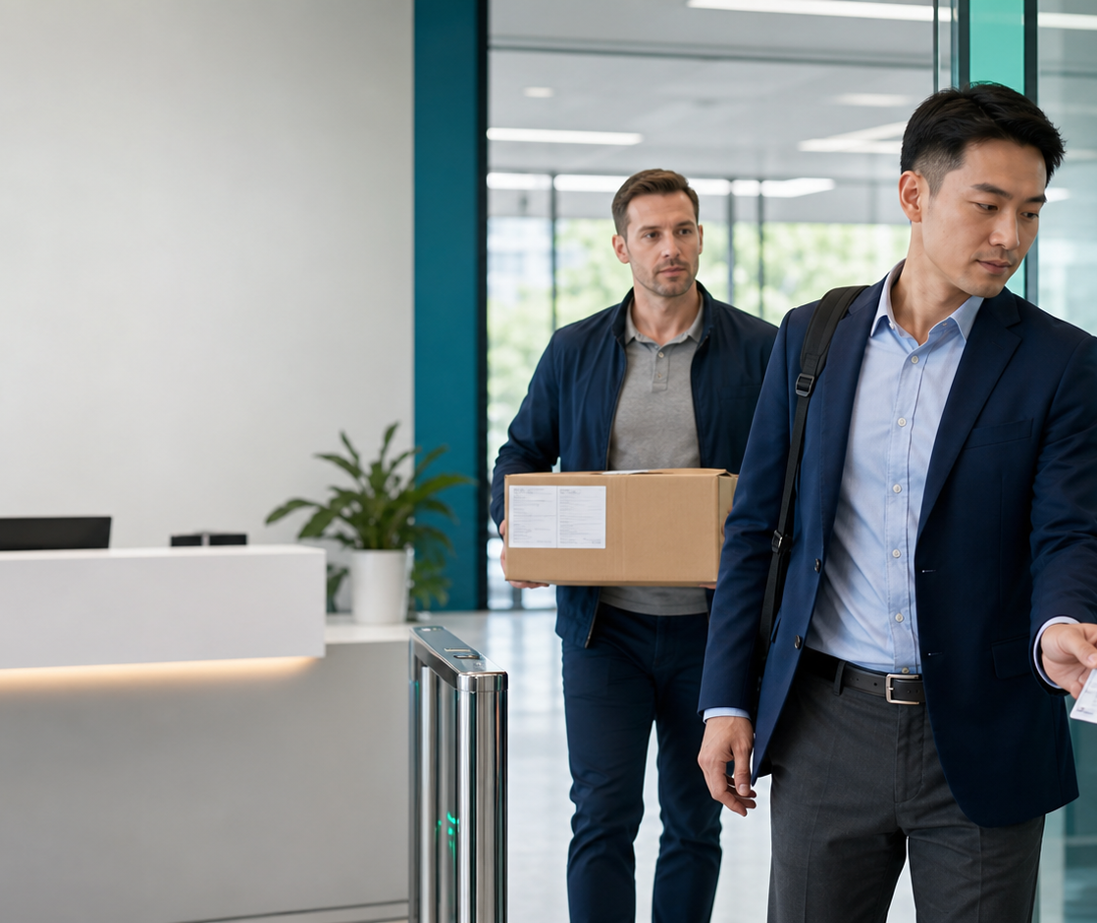
SOCIAL ENGINEERING 12 OF 16
Tailgating: see it in everyday life
1
WHAT IT CAN LOOK LIKE
Someone carrying boxes asks you to hold the secure door because ‘my access card is in the car’.
2
SPOT THESE CLUES
Visitor avoids reception or relies on politeness and a carried object
3
DO THIS INSTEAD
Challenge politely or escort the person to reception
How it works: An unauthorised person follows an authorised user through a controlled entrance
C506 | v1.0
Source: https://www.police.gov.sg/-/media/SPF/Media-Room/Statistics/Annual-Scams-and-Cybercrime-Brief-2025/Ann…

Slide 43
SOCIAL ENGINEERING 13 OF 16
Shoulder surfing: see it in everyday life
1
WHAT IT CAN LOOK LIKE
A stranger watches you enter a phone PIN on a crowded train, then follows where you keep the device.
2
SPOT THESE CLUES
Crowded space, exposed screen or sensitive conversation
3
DO THIS INSTEAD
Use privacy awareness, screen positioning and clean-desk habits
How it works: Information is observed directly from screens, keyboards, documents or conversations
C506 | v1.0
Source: https://www.police.gov.sg/-/media/SPF/Media-Room/Statistics/Annual-Scams-and-Cybercrime-Brief-2025/Ann…

Slide 44
SOCIAL ENGINEERING 14 OF 16
Dumpster diving: see it in everyday life
1
WHAT IT CAN LOOK LIKE
Printed customer labels and an old USB drive are placed in ordinary rubbish.
2
SPOT THESE CLUES
Sensitive printouts, labels or storage media in normal waste
3
DO THIS INSTEAD
Secure disposal, shredding and verified media destruction
How it works: Discarded documents or devices reveal identities, systems or business information
C506 | v1.0
Source: https://www.police.gov.sg/-/media/SPF/Media-Room/Statistics/Annual-Scams-and-Cybercrime-Brief-2025/Ann…

Slide 45
SOCIAL ENGINEERING 15 OF 16
Watering-hole deception: see it in everyday life
1
WHAT IT CAN LOOK LIKE
A familiar industry forum suddenly asks you to install a ‘document viewer’ before reading a post.
2
SPOT THESE CLUES
Unexpected login, download or browser warning on a familiar niche site
3
DO THIS INSTEAD
Patch browsers, limit execution and verify unusual site behaviour
How it works: A site trusted by a target community is compromised or imitated to reach that group
C506 | v1.0
Source: https://www.police.gov.sg/-/media/SPF/Media-Room/Statistics/Annual-Scams-and-Cybercrime-Brief-2025/Ann…

Slide 46
SOCIAL ENGINEERING 16 OF 16
MFA fatigue / push bombing: see it in everyday life
1
WHAT IT CAN LOOK LIKE
Your phone shows six login approvals, then ‘IT support’ calls and tells you to approve the next one.
2
SPOT THESE CLUES
Multiple unexpected prompts followed by a call claiming to be support
3
DO THIS INSTEAD
Deny, report, change credentials and prefer number matching or passkeys
How it works: Repeated authentication prompts pressure a user to approve one to make them stop
C506 | v1.0
Source: https://www.police.gov.sg/-/media/SPF/Media-Room/Statistics/Annual-Scams-and-Cybercrime-Brief-2025/Ann…

Slide 47
BEGINNER EXAMPLE
01
Phishing email example: parcel delivery
SYNTHETIC CLASSROOM EXAMPLE
EMAIL
WHAT SHOULD MAKE YOU PAUSE?
1
CLUE 1
MAIL • INBOX • MESSAGE
Unexpected small payment
From
Parcel Updates <notify@parcel-status.example.test>
CLUE 2
2
Reply-to
claims@parcel-help.example.test
Sender and reply-to differ
Subject
Final notice: S$1.20 delivery fee
3
CLUE 3
Hello,
Urgency creates pressure
We could not deliver your parcel. Pay S$1.20 within 30 minutes or it will be returned.
4
CLUE 4
Link is not the courier's known site
PAY DELIVERY FEE
Mock message — do not click
SAFER RESPONSE
Open the courier's official app or type its known address. Do not use the email link.
C506 | v1.0

Slide 48
BEGINNER EXAMPLE
02
Phishing email: genuine or suspicious?
SYNTHETIC CLASSROOM EXAMPLE
EMAIL
WHAT SHOULD MAKE YOU PAUSE?
1
CLUE 1
MAIL • INBOX • MESSAGE
Threat of losing access
From
HR Shared Services <benefits@company.example.test>
CLUE 2
2
Reply-to
benefits-help@external-mail.example.test
Unusual external reply-to
Subject
Urgent: benefits account expires today
3
CLUE 3
Hello,
Unexpected sign-in link
Sign in now to keep your medical benefits. You have 20 minutes before access is removed.
4
CLUE 4
No matching notice in the HR portal
KEEP MY BENEFITS
Mock message — do not click
SAFER RESPONSE
Use the bookmarked HR portal or call HR on the directory number.
C506 | v1.0

Slide 49
BEGINNER EXAMPLE
03
BEC email example: changed bank details
SYNTHETIC CLASSROOM EXAMPLE
EMAIL
WHAT SHOULD MAKE YOU PAUSE?
1
CLUE 1
MAIL • INBOX • MESSAGE
Lookalike domain uses the digit 1
From
Lee Supplies <accounts@lee-supp1ies.example.test>
CLUE 2
2
Reply-to
payments@lee-supp1ies.example.test
Bank details changed
Subject
RE: INV-2048 — new bank account
3
CLUE 3
Hello,
Same-day payment pressure
Our bank account changed today. Please pay S$48,700 to the attached account before 3 pm. Reply only to this email.
4
CLUE 4
Request bypasses normal verification
OPEN NEW BANK DETAILS
Mock message — do not click
SAFER RESPONSE
Stop payment and call the supplier using the number already stored in the vendor record.
C506 | v1.0

Slide 50
BEGINNER EXAMPLE
04
Smishing example: account locked
SYNTHETIC CLASSROOM EXAMPLE
SMS
WHAT SHOULD MAKE YOU PAUSE?
1
CLUE 1
Fear of account loss
MESSAGES
2
CLUE 2
BANK SECURITY: Your account is locked. Verify now at bank-verify.example.test or access will be suspended.
Link asks for a bank login
3
CLUE 3
Generic sender name
4
CLUE 4
Unknown sender • 10:42
Message is unexpected
SAFER RESPONSE
Open the official banking app independently and use its support number if needed.
C506 | v1.0

Slide 51
BEGINNER EXAMPLE
05
Vishing example: the fake fraud-team call
SYNTHETIC CLASSROOM EXAMPLE
PHONE CALL
WHAT SHOULD MAKE YOU PAUSE?
1
CLUE 1
?
INCOMING CALL
Caller creates fear
‘Bank Fraud Team’
2
CLUE 2
Caller ID can be spoofed
Requests an authentication code
Caller: ‘There is a S$2,900 transfer pending. Read me the six-digit code now so I can cancel it.’
3
CLUE 3
Demands immediate action
4
CLUE 4
Caller ID can be spoofed
The bank will not need your one-time code to cancel a transfer.
SAFER RESPONSE
End the call. Dial the number on the back of the bank card or in the official app.
C506 | v1.0

Slide 52
BEGINNER EXAMPLE
06
QR phishing example: scan to pay
SYNTHETIC CLASSROOM EXAMPLE
QR POSTER
WHAT SHOULD MAKE YOU PAUSE?
1
CLUE 1
PARKING NOTICE
Sticker may cover a genuine code
SCAN NOW TO AVOID A S$70 FINE
2
CLUE 2
Destination is hidden until scanning
3
CLUE 3
Fine creates urgency
4
CLUE 4
Site is not the known parking operator
NON-SCANNABLE MOCK QR
SAFER RESPONSE
Use the official parking app or type the operator's known address.
Preview: pay-parking.example.test
C506 | v1.0

Slide 53
BEGINNER EXAMPLE
07
MFA fatigue example: repeated prompts
SYNTHETIC CLASSROOM EXAMPLE
AUTHENTICATION APP
WHAT SHOULD MAKE YOU PAUSE?
1
CLUE 1
You did not start a login
SIGN-IN REQUEST
2
CLUE 2
Approve sign-in? Attempt 4 of 6
Prompts repeat
Approve sign-in? Attempt 5 of 6
3
CLUE 3
Approve sign-in? Attempt 6 of 6
A caller asks you to approve
4
CLUE 4
Six login approval prompts arrive, followed by a call: ‘This is IT. Approve the next one to stop the alerts.’
Approval would authorise the attacker
SAFER RESPONSE
Deny, report the prompts, change the password from a trusted device and review active sessions.
C506 | v1.0

Slide 54
BEGINNER EXAMPLE
08
Physical social engineering examples
SYNTHETIC CLASSROOM EXAMPLE
WORKPLACE
WHAT SHOULD MAKE YOU PAUSE?
1
CLUE 1
1
TAILGATING
Politeness is used as pressure
A person carrying boxes asks you to hold a secure door: ‘My access card is in the car.’
2
CLUE 2
No visible access or appointment
3
CLUE 3
PRETEXTING
Role sounds plausible but is unverified
2
A ‘new auditor’ asks for the staff list and VPN guide before an unverified inspection.
4
CLUE 4
Request exceeds need-to-know
SAFER RESPONSE
A convincing story is not proof of identity or authority.
Escort the person to reception and verify identity, appointment, authority and need-to-know.
C506 | v1.0

Slide 55
EMAIL TRIAGE
Phishing and BEC: inspect the whole request
1
Identity
2
Context
3
Request
4
Evidence
5
Verify
Display name, exact domain and reply-to
Expected relationship, timing and channel
Money, credentials, data or action
Links, attachments, language and headers
Independent channel and known contact
Do not use contact details supplied inside the suspicious message.
C506 | v1.0

Slide 56
SAME PSYCHOLOGY • DIFFERENT SURFACE
Scams move across channels
Smishing
Vishing
QR phishing
SMS or messaging link designed to steal data or install software.
Voice call creates urgency or impersonates authority.
A code hides the destination and moves the user to mobile.
Social account takeover
E-commerce fraud
Tech-support scam
A familiar identity asks for money, codes or access.
Fake listing, payment page, refund or delivery notice.
Attacker persuades the user to install remote-control software.
C506 | v1.0

Slide 57
NETWORK THREATS
Networks face passive and active attacks
Passive observation
Man-in-the-middle
Spoofing
Traffic analysis or eavesdropping seeks information without changing the system.
An attacker intercepts or alters communication between trusted endpoints.
A source identity, address or service is imitated to gain trust.
DDoS
Rogue wireless
Lateral movement
Many sources exhaust service capacity and reduce availability.
A fake or unsafe access point captures traffic or credentials.
Compromise spreads through excessive trust between systems.
C506 | v1.0

Slide 58
AVAILABILITY
DDoS is an availability attack
WHAT HAPPENS
RESILIENCE
✓
Traffic or requests overwhelm capacity
✓
Rate limits and filtering
✓
Legitimate users cannot reach the service
✓
Content delivery and traffic scrubbing
✓
Attack may distract from another intrusion
✓
Capacity and failover planning
✓
Cloud and upstream support may be required
✓
Provider escalation runbook
C506 | v1.0
Source: https://www.cisco.com/site/us/en/learn/topics/security/what-is-cybersecurity.html

Slide 59
MOBILE SECURITY
Mobile devices concentrate identity and access
Risks
Baseline
Judgement
Malicious apps, unsafe permissions, lost device, SIM swap, QR phishing and untrusted Wi-Fi.
Supported OS, automatic updates, screen lock, encryption, remote locate/wipe and safe app sources.
Treat unexpected MFA prompts and recovery messages as potential account takeover.
C506 | v1.0

Slide 60
CYBER WARFARE • ESPIONAGE • RESILIENCE
Nation-state and critical-infrastructure risk
Patient access
Trusted pathways
Civil consequence
Individual role
Long dwell time and low-noise collection can matter more than immediate disruption.
Suppliers, identities and management tools offer broad reach.
Essential services connect cyber resilience with public safety and national security.
Reporting anomalies and protecting credentials still breaks high-end attack chains.
C506 | v1.0

Slide 61
PRIVACY TRADE-OFFS
Security, privacy and lawful access
PROTECTION
GOVERNANCE
✓
Encryption protects confidentiality in transit and at rest
✓
Use must be authorised and proportionate
✓
Access controls limit who can use data
✓
Retention and monitoring need policy
✓
Logging creates accountability
✓
Escalate legal or ethical uncertainty
✓
Data minimisation reduces exposure
✓
Do not bypass controls for convenience
C506 | v1.0

Slide 62
REAL-WORLD CASE
01
SingHealth data breach
Singapore, 2018
1
ENTRY
2
WEAKNESS
3
IMPACT
Compromised front-end workstation and privileged credentials
Endpoint compromise, credential misuse, delayed detection
Personal particulars of 1.5 million patients; outpatient medication records of 160,000
WHAT DEFENDERS COULD SEE
CONTROLS THAT BREAK THE CHAIN
TRANSFERABLE LESSON
Unusual database queries, privileged access, suspicious workstation activity
Endpoint hardening, least privilege, privileged access monitoring, segmented systems, rehearsed response
Identity and endpoint signals must be connected before an intruder reaches sensitive data.
SOURCE: Ministry of Health Singapore • SingHealth's IT System Target of Cyberattack • moh.gov.sg • CLICK TO OPEN OFFICIAL SOURCE
C506 | v1.0
Source: https://www.moh.gov.sg/newsroom/singhealth%27s-it-system-target-of-cyberattack/

Slide 63
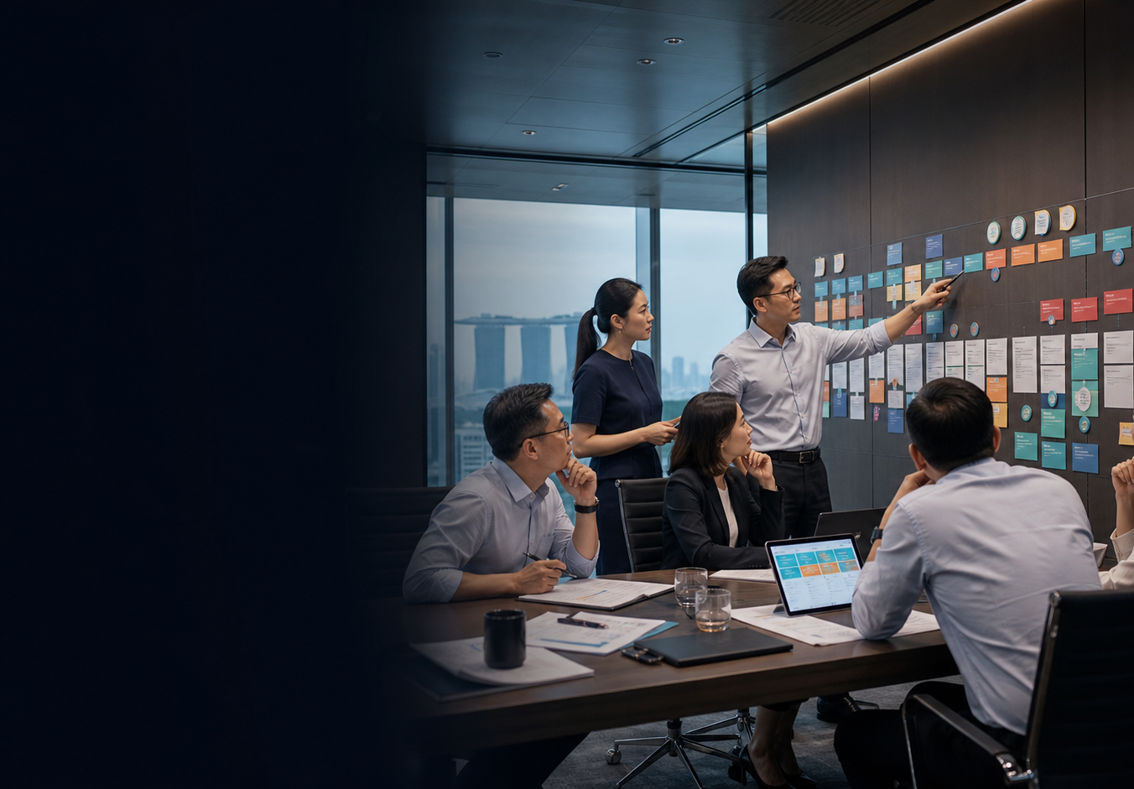
CASE DISCUSSION
01
Decision room: SingHealth data breach
TEAM DISCUSSION • 8 MIN
1
TRIAGE
Which evidence would you trust first: Unusual database queries, privileged access, suspicious workstation activity?
2
DECISION
Which immediate action limits personal particulars of 1.5 million patients; outpatient medication records of 160,000 without destroying evidence?
3
CONTROL
Which one control should be verified first from: Endpoint hardening, least privilege, privileged access monitoring, segmented systems, rehearsed response?
4
TRANSFER
Where could the same entry path exist in a personal account or small business today?
SOURCE: Ministry of Health Singapore • SingHealth's IT System Target of Cyberattack • moh.gov.sg • CLICK TO OPEN OFFICIAL SOURCE
C506 | v1.0
Source: https://www.moh.gov.sg/newsroom/singhealth%27s-it-system-target-of-cyberattack/

Slide 64
REAL-WORLD CASE
02
WannaCry and the NHS
United Kingdom, 2017
1
ENTRY
2
WEAKNESS
3
IMPACT
Ransomware exploited unpatched Windows systems
Patch gaps, unsupported systems, uneven asset visibility
Disruption across NHS organisations and cancelled care
WHAT DEFENDERS COULD SEE
CONTROLS THAT BREAK THE CHAIN
TRANSFERABLE LESSON
Rapid lateral spread, inaccessible files, ransom notes, unavailable clinical systems
Asset inventory, timely patching, supported platforms, segmentation, tested offline recovery
A known vulnerability becomes an operational crisis when ownership and patching fail.
SOURCE: UK National Audit Office • Investigation: WannaCry Cyber Attack and the NHS • nao.org.uk • CLICK TO OPEN OFFICIAL SOURCE
C506 | v1.0
Source: https://www.nao.org.uk/reports/investigation-wannacry-cyber-attack-and-the-nhs/

Slide 65
CASE DISCUSSION
02
Decision room: WannaCry and the NHS
TEAM DISCUSSION • 8 MIN
1
TRIAGE
Which evidence would you trust first: Rapid lateral spread, inaccessible files, ransom notes, unavailable clinical systems?
2
DECISION
Which immediate action limits disruption across nhs organisations and cancelled care without destroying evidence?
3
CONTROL
Which one control should be verified first from: Asset inventory, timely patching, supported platforms, segmentation, tested offline recovery?
4
TRANSFER
Where could the same entry path exist in a personal account or small business today?
SOURCE: UK National Audit Office • Investigation: WannaCry Cyber Attack and the NHS • nao.org.uk • CLICK TO OPEN OFFICIAL SOURCE
C506 | v1.0
Source: https://www.nao.org.uk/reports/investigation-wannacry-cyber-attack-and-the-nhs/

Slide 66
REAL-WORLD CASE
03
Equifax breach
United States, 2017
1
ENTRY
2
WEAKNESS
3
IMPACT
Exploitation of a known web application vulnerability
Patch and asset-management breakdowns
Sensitive personal information exposed at massive scale
WHAT DEFENDERS COULD SEE
CONTROLS THAT BREAK THE CHAIN
TRANSFERABLE LESSON
Unusual web traffic and data access; vulnerable internet-facing service
Complete asset inventory, vulnerability SLAs, compensating controls, verification after patching
A patch notice is not a control until the affected asset is found, fixed and verified.
SOURCE: U.S. House Committee on Oversight • The Equifax Data Breach • oversight.house.gov • CLICK TO OPEN OFFICIAL SOURCE
C506 | v1.0
Source: https://oversight.house.gov/report/the-equifax-data-breach/

Slide 67
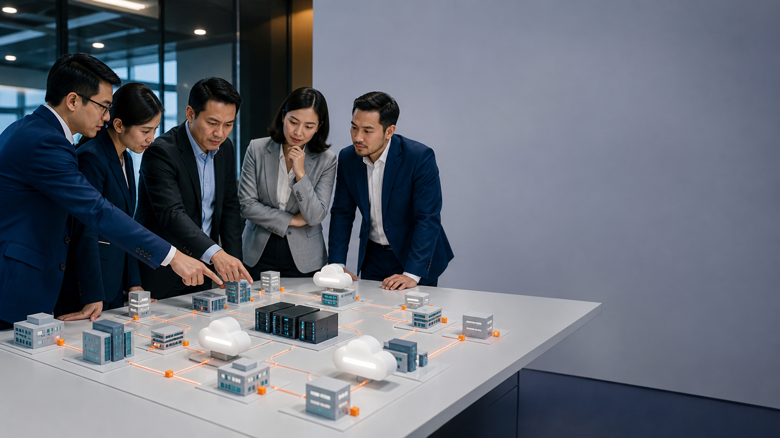
CASE DISCUSSION
03
Decision room: Equifax breach
TEAM DISCUSSION • 8 MIN
1
TRIAGE
Which evidence would you trust first: Unusual web traffic and data access; vulnerable internet-facing service?
2
DECISION
Which immediate action limits sensitive personal information exposed at massive scale without destroying evidence?
3
CONTROL
Which one control should be verified first from: Complete asset inventory, vulnerability SLAs, compensating controls, verification after patching?
4
TRANSFER
Where could the same entry path exist in a personal account or small business today?
SOURCE: U.S. House Committee on Oversight • The Equifax Data Breach • oversight.house.gov • CLICK TO OPEN OFFICIAL SOURCE
C506 | v1.0
Source: https://oversight.house.gov/report/the-equifax-data-breach/

Slide 68
REAL-WORLD CASE
04
SolarWinds supply-chain compromise
Global, 2020
1
ENTRY
2
WEAKNESS
3
IMPACT
Malicious code inserted into trusted software updates
Implicit trust in supplier software and privileged management tooling
Covert access to public- and private-sector networks
WHAT DEFENDERS COULD SEE
CONTROLS THAT BREAK THE CHAIN
TRANSFERABLE LESSON
Rare identity use, unusual cloud access, unexpected network paths
Supplier risk management, zero-trust checks, identity analytics, egress monitoring, rapid key rotation
Trusted software can carry risk; verify behaviour after deployment, not only the publisher.
SOURCE: CISA • Active Exploitation of SolarWinds Software • cisa.gov • CLICK TO OPEN OFFICIAL SOURCE
C506 | v1.0
Source: https://www.cisa.gov/news-events/alerts/2020/12/13/active-exploitation-solarwinds-software

Slide 69
CASE DISCUSSION
04
Decision room: SolarWinds supply-chain compromise
TEAM DISCUSSION • 8 MIN
1
TRIAGE
Which evidence would you trust first: Rare identity use, unusual cloud access, unexpected network paths?
2
DECISION
Which immediate action limits covert access to public- and private-sector networks without destroying evidence?
3
CONTROL
Which one control should be verified first from: Supplier risk management, zero-trust checks, identity analytics, egress monitoring, rapid key rotation?
4
TRANSFER
Where could the same entry path exist in a personal account or small business today?
SOURCE: CISA • Active Exploitation of SolarWinds Software • cisa.gov • CLICK TO OPEN OFFICIAL SOURCE
C506 | v1.0
Source: https://www.cisa.gov/news-events/alerts/2020/12/13/active-exploitation-solarwinds-software

Slide 70
REAL-WORLD CASE
05
Colonial Pipeline
United States, 2021
1
ENTRY
2
WEAKNESS
3
IMPACT
Compromised VPN password on an inactive account without MFA
Dormant identity, password reuse/exposure, missing MFA
Business systems disruption and precautionary pipeline shutdown
WHAT DEFENDERS COULD SEE
CONTROLS THAT BREAK THE CHAIN
TRANSFERABLE LESSON
Unexpected remote access and activity from a dormant account
Disable dormant accounts, MFA, password monitoring, remote-access review, IT/OT separation
Identity hygiene is infrastructure resilience.
SOURCE: CISA • IAM Case Study: Colonial Pipeline • cisa.gov • CLICK TO OPEN OFFICIAL SOURCE
C506 | v1.0
Source: https://www.cisa.gov/sites/default/files/2023-12/IAM_EDUCATIONAL_AID_TALKING_POINTS_508C.pdf

Slide 71
CASE DISCUSSION
05
Decision room: Colonial Pipeline
TEAM DISCUSSION • 8 MIN
1
TRIAGE
Which evidence would you trust first: Unexpected remote access and activity from a dormant account?
2
DECISION
Which immediate action limits business systems disruption and precautionary pipeline shutdown without destroying evidence?
3
CONTROL
Which one control should be verified first from: Disable dormant accounts, MFA, password monitoring, remote-access review, IT/OT separation?
4
TRANSFER
Where could the same entry path exist in a personal account or small business today?
SOURCE: CISA • IAM Case Study: Colonial Pipeline • cisa.gov • CLICK TO OPEN OFFICIAL SOURCE
C506 | v1.0
Source: https://www.cisa.gov/sites/default/files/2023-12/IAM_EDUCATIONAL_AID_TALKING_POINTS_508C.pdf

Slide 72
REAL-WORLD CASE
06
Log4Shell exploitation
Global, 2021
1
ENTRY
2
WEAKNESS
3
IMPACT
Remote code execution through a widely embedded logging component
Hidden software dependency and incomplete inventory
Broad exploitation risk across internet-facing systems
WHAT DEFENDERS COULD SEE
CONTROLS THAT BREAK THE CHAIN
TRANSFERABLE LESSON
Suspicious lookup strings, outbound callbacks, new processes and payloads
Software bill of materials, emergency patch process, virtual patching, threat hunting
You cannot protect a component you do not know you run.
SOURCE: CISA • Mitigating Log4Shell and Log4j Vulnerabilities • cisa.gov • CLICK TO OPEN OFFICIAL SOURCE
C506 | v1.0
Source: https://www.cisa.gov/news-events/cybersecurity-advisories/aa21-356a

Slide 73
CASE DISCUSSION
06
Decision room: Log4Shell exploitation
TEAM DISCUSSION • 8 MIN
1
TRIAGE
Which evidence would you trust first: Suspicious lookup strings, outbound callbacks, new processes and payloads?
2
DECISION
Which immediate action limits broad exploitation risk across internet-facing systems without destroying evidence?
3
CONTROL
Which one control should be verified first from: Software bill of materials, emergency patch process, virtual patching, threat hunting?
4
TRANSFER
Where could the same entry path exist in a personal account or small business today?
SOURCE: CISA • Mitigating Log4Shell and Log4j Vulnerabilities • cisa.gov • CLICK TO OPEN OFFICIAL SOURCE
C506 | v1.0
Source: https://www.cisa.gov/news-events/cybersecurity-advisories/aa21-356a

Slide 74
REAL-WORLD CASE
07
MOVEit mass exploitation
Global, 2023
1
ENTRY
2
WEAKNESS
3
IMPACT
Zero-day SQL injection in managed file-transfer software
Internet-facing data service and third-party concentration
Data theft across many organisations through one common platform
WHAT DEFENDERS COULD SEE
CONTROLS THAT BREAK THE CHAIN
TRANSFERABLE LESSON
Unexpected database queries, web shells, unusual downloads and new accounts
Vendor advisories, rapid isolation, compromise assessment, third-party exposure mapping
Third-party software can multiply one vulnerability into sector-wide exposure.
SOURCE: CISA • CL0P Exploits MOVEit Vulnerability • cisa.gov • CLICK TO OPEN OFFICIAL SOURCE
C506 | v1.0
Source: https://www.cisa.gov/sites/default/files/2023-06/aa23-158a-stopransomware-cl0p-ransomware-gang-exploit…

Slide 75
CASE DISCUSSION
07
Decision room: MOVEit mass exploitation
TEAM DISCUSSION • 8 MIN
1
TRIAGE
Which evidence would you trust first: Unexpected database queries, web shells, unusual downloads and new accounts?
2
DECISION
Which immediate action limits data theft across many organisations through one common platform without destroying evidence?
3
CONTROL
Which one control should be verified first from: Vendor advisories, rapid isolation, compromise assessment, third-party exposure mapping?
4
TRANSFER
Where could the same entry path exist in a personal account or small business today?
SOURCE: CISA • CL0P Exploits MOVEit Vulnerability • cisa.gov • CLICK TO OPEN OFFICIAL SOURCE
C506 | v1.0
Source: https://www.cisa.gov/sites/default/files/2023-06/aa23-158a-stopransomware-cl0p-ransomware-gang-exploit…

Slide 76
REAL-WORLD CASE
08
MGM Resorts cyber incident
United States, 2023
1
ENTRY
2
WEAKNESS
3
IMPACT
Identity compromise followed by system disruption
Help-desk and identity-recovery processes exposed to manipulation
Systems shut down, service disruption and personal data exposure
WHAT DEFENDERS COULD SEE
CONTROLS THAT BREAK THE CHAIN
TRANSFERABLE LESSON
Unusual identity recovery, privileged account changes and abrupt service outages
High-assurance help-desk verification, phishing-resistant MFA, privileged identity monitoring
Recovery workflows need controls as strong as login workflows.
SOURCE: U.S. Securities and Exchange Commission • MGM Resorts International Form 8-K • sec.gov • CLICK TO OPEN OFFICIAL SOURCE
C506 | v1.0
Source: https://www.sec.gov/Archives/edgar/data/789570/000119312523251667/d461062d8k.htm

Slide 77
CASE DISCUSSION
08
Decision room: MGM Resorts cyber incident
TEAM DISCUSSION • 8 MIN
1
TRIAGE
Which evidence would you trust first: Unusual identity recovery, privileged account changes and abrupt service outages?
2
DECISION
Which immediate action limits systems shut down, service disruption and personal data exposure without destroying evidence?
3
CONTROL
Which one control should be verified first from: High-assurance help-desk verification, phishing-resistant MFA, privileged identity monitoring?
4
TRANSFER
Where could the same entry path exist in a personal account or small business today?
SOURCE: U.S. Securities and Exchange Commission • MGM Resorts International Form 8-K • sec.gov • CLICK TO OPEN OFFICIAL SOURCE
C506 | v1.0
Source: https://www.sec.gov/Archives/edgar/data/789570/000119312523251667/d461062d8k.htm

Slide 78
REAL-WORLD CASE
09
Singapore commodity-trader BEC
Singapore, 2026
1
ENTRY
2
WEAKNESS
3
IMPACT
Supplier impersonation using a subtly transposed email domain
Payment change accepted without independent verification
USD 6.6 million transferred; funds recovered after rapid reporting and international cooperation
WHAT DEFENDERS COULD SEE
CONTROLS THAT BREAK THE CHAIN
TRANSFERABLE LESSON
Changed bank details, lookalike domain, urgency and unusual payment instructions
Call-back verification using known contacts, dual approval, domain checks, rapid bank and police escalation
A two-minute independent check can prevent a multi-million-dollar loss.
SOURCE: Singapore Police Force • Recovery of Over USD 6.6 Million in BEC Case • police.gov.sg • CLICK TO OPEN OFFICIAL SOURCE
C506 | v1.0
Source: https://www.police.gov.sg/media-hub/news/2026/05/20260505_international_cooperation_leads_to_the_recov…

Slide 79
CASE DISCUSSION
09
Decision room: Singapore commodity-trader BEC
TEAM DISCUSSION • 8 MIN
1
TRIAGE
Which evidence would you trust first: Changed bank details, lookalike domain, urgency and unusual payment instructions?
2
DECISION
Which immediate action limits usd 6.6 million transferred; funds recovered after rapid reporting and international cooperation without destroying evidence?
3
CONTROL
Which one control should be verified first from: Call-back verification using known contacts, dual approval, domain checks, rapid bank and police escalation?
4
TRANSFER
Where could the same entry path exist in a personal account or small business today?
SOURCE: Singapore Police Force • Recovery of Over USD 6.6 Million in BEC Case • police.gov.sg • CLICK TO OPEN OFFICIAL SOURCE
C506 | v1.0
Source: https://www.police.gov.sg/media-hub/news/2026/05/20260505_international_cooperation_leads_to_the_recov…

Slide 80
REAL-WORLD CASE
10
Target payment-card breach
United States, 2013
1
ENTRY
2
WEAKNESS
3
IMPACT
Stolen third-party vendor credentials enabled access into the retailer environment
Supplier access, weak separation and missed opportunities to act on security alerts
Payment-card information and personal data associated with tens of millions of customers were exposed
WHAT DEFENDERS COULD SEE
CONTROLS THAT BREAK THE CHAIN
TRANSFERABLE LESSON
Malware alerts, unusual internal movement and outbound data transfers
Supplier MFA, segmented vendor access, alert ownership, egress monitoring and tested incident escalation
A low-privilege supplier pathway can become a high-impact route when trust boundaries are weak.
SOURCE: U.S. Senate Committee on Commerce • Target's Missed Opportunities to Stop a Data Breach • commerce.senate.gov • CLICK TO OPEN OFFICIAL SOURCE
C506 | v1.0
Source: https://www.commerce.senate.gov/press/dem/release/rockefeller-staff-report-details-targets-missed-oppo…

Slide 81
CASE DISCUSSION
10
Decision room: Target payment-card breach
TEAM DISCUSSION • 8 MIN
1
TRIAGE
Which evidence would you trust first: Malware alerts, unusual internal movement and outbound data transfers?
2
DECISION
Which immediate action limits payment-card information and personal data associated with tens of millions of customers were exposed without destroying evidence?
3
CONTROL
Which one control should be verified first from: Supplier MFA, segmented vendor access, alert ownership, egress monitoring and tested incident escalation?
4
TRANSFER
Where could the same entry path exist in a personal account or small business today?
SOURCE: U.S. Senate Committee on Commerce • Target's Missed Opportunities to Stop a Data Breach • commerce.senate.gov • CLICK TO OPEN OFFICIAL SOURCE
C506 | v1.0
Source: https://www.commerce.senate.gov/press/dem/release/rockefeller-staff-report-details-targets-missed-oppo…

Slide 82
REAL-WORLD CASE
11
NotPetya disruption at Maersk
Global shipping, 2017
1
ENTRY
2
WEAKNESS
3
IMPACT
Destructive malware entered through compromised Ukrainian accounting software and spread globally
Trusted software pathway, flat connectivity and operational dependence on shared digital services
Global applications and data were unavailable for days; port and shipping operations were disrupted
WHAT DEFENDERS COULD SEE
CONTROLS THAT BREAK THE CHAIN
TRANSFERABLE LESSON
Rapid cross-site outages, unavailable systems and destructive behaviour rather than a recoverable ransom event
Supplier risk controls, segmentation, isolated recovery capability, offline identity services and business workarounds
An organisation can suffer severe collateral damage even when it is not the intended target.
SOURCE: UK Department for Transport • Cyber Security for Ports and Port Systems • assets.publishing.service.gov.uk • CLICK TO OPEN OFFICIAL SOURCE
C506 | v1.0
Source: https://assets.publishing.service.gov.uk/government/uploads/system/uploads/attachment_data/file/546160…

Slide 83
CASE DISCUSSION
11
Decision room: NotPetya disruption at Maersk
TEAM DISCUSSION • 8 MIN
1
TRIAGE
Which evidence would you trust first: Rapid cross-site outages, unavailable systems and destructive behaviour rather than a recoverable ransom event?
2
DECISION
Which immediate action limits global applications and data were unavailable for days; port and shipping operations were disrupted without destroying evidence?
3
CONTROL
Which one control should be verified first from: Supplier risk controls, segmentation, isolated recovery capability, offline identity services and business workarounds?
4
TRANSFER
Where could the same entry path exist in a personal account or small business today?
SOURCE: UK Department for Transport • Cyber Security for Ports and Port Systems • assets.publishing.service.gov.uk • CLICK TO OPEN OFFICIAL SOURCE
C506 | v1.0
Source: https://assets.publishing.service.gov.uk/government/uploads/system/uploads/attachment_data/file/546160…

Slide 84
REAL-WORLD CASE
12
Marriott Starwood data breach
Global hospitality, disclosed 2018
1
ENTRY
2
WEAKNESS
3
IMPACT
Long-running unauthorised access in an acquired reservation environment
Acquisition due diligence, legacy-system monitoring and delayed detection
Large-scale exposure of guest records and sustained regulatory and customer consequences
WHAT DEFENDERS COULD SEE
CONTROLS THAT BREAK THE CHAIN
TRANSFERABLE LESSON
Compromised accounts, database activity and anomalous access within a legacy environment
Pre-acquisition security assurance, rapid integration, identity reset, continuous monitoring and data minimisation
Cyber risk transfers with an acquisition unless inherited systems and identities are independently verified.
SOURCE: UK Information Commissioner's Office • Marriott International Monetary Penalty Notice • ico.org.uk • CLICK TO OPEN OFFICIAL SOURCE
C506 | v1.0
Source: https://ico.org.uk/media/action-weve-taken/mpns/2618524/marriott-international-inc-mpn-20201030.pdf

Slide 85
CASE DISCUSSION
12
Decision room: Marriott Starwood data breach
TEAM DISCUSSION • 8 MIN
1
TRIAGE
Which evidence would you trust first: Compromised accounts, database activity and anomalous access within a legacy environment?
2
DECISION
Which immediate action limits large-scale exposure of guest records and sustained regulatory and customer consequences without destroying evidence?
3
CONTROL
Which one control should be verified first from: Pre-acquisition security assurance, rapid integration, identity reset, continuous monitoring and data minimisation?
4
TRANSFER
Where could the same entry path exist in a personal account or small business today?
SOURCE: UK Information Commissioner's Office • Marriott International Monetary Penalty Notice • ico.org.uk • CLICK TO OPEN OFFICIAL SOURCE
C506 | v1.0
Source: https://ico.org.uk/media/action-weve-taken/mpns/2618524/marriott-international-inc-mpn-20201030.pdf

Slide 86
REAL-WORLD CASE
13
Capital One cloud data breach
United States, 2019
1
ENTRY
2
WEAKNESS
3
IMPACT
A misconfigured web application firewall enabled access to cloud-hosted data
Cloud configuration and permission design allowed excessive access
Data from millions of credit applications was accessed
WHAT DEFENDERS COULD SEE
CONTROLS THAT BREAK THE CHAIN
TRANSFERABLE LESSON
Unexpected cloud API activity, unusual data access and exploitation of an internet-facing control
Least-privilege cloud roles, configuration assurance, logging, anomaly detection and rapid credential revocation
Cloud services inherit the organisation's configuration decisions; provider security does not remove customer responsibility.
SOURCE: U.S. Department of Justice • Seattle Tech Worker Arrested for Data Theft • justice.gov • CLICK TO OPEN OFFICIAL SOURCE
C506 | v1.0
Source: https://www.justice.gov/usao-wdwa/pr/seattle-tech-worker-arrested-data-theft-involving-large-financial…

Slide 87
CASE DISCUSSION
13
Decision room: Capital One cloud data breach
TEAM DISCUSSION • 8 MIN
1
TRIAGE
Which evidence would you trust first: Unexpected cloud API activity, unusual data access and exploitation of an internet-facing control?
2
DECISION
Which immediate action limits data from millions of credit applications was accessed without destroying evidence?
3
CONTROL
Which one control should be verified first from: Least-privilege cloud roles, configuration assurance, logging, anomaly detection and rapid credential revocation?
4
TRANSFER
Where could the same entry path exist in a personal account or small business today?
SOURCE: U.S. Department of Justice • Seattle Tech Worker Arrested for Data Theft • justice.gov • CLICK TO OPEN OFFICIAL SOURCE
C506 | v1.0
Source: https://www.justice.gov/usao-wdwa/pr/seattle-tech-worker-arrested-data-theft-involving-large-financial…

Slide 88
REAL-WORLD CASE
14
Norsk Hydro LockerGoga ransomware
Norway and global operations, 2019
1
ENTRY
2
WEAKNESS
3
IMPACT
Ransomware disrupted corporate and operational workstations
Enterprise connectivity allowed IT disruption to affect industrial operations
Plants shifted to manual workarounds while systems were rebuilt and restored
WHAT DEFENDERS COULD SEE
CONTROLS THAT BREAK THE CHAIN
TRANSFERABLE LESSON
Unavailable workstations, encryption activity and loss of normal production-support systems
IT/OT segmentation, rehearsed manual operations, clean rebuild capability, transparent communications and tested backups
Operational resilience includes safe manual workarounds, not only technical restoration.
SOURCE: UK National Cyber Security Centre • What Is OT Malware? • ncsc.gov.uk • CLICK TO OPEN OFFICIAL SOURCE
C506 | v1.0
Source: https://www.ncsc.gov.uk/blog-post/what-is-ot-malware

Slide 89
CASE DISCUSSION
14
Decision room: Norsk Hydro LockerGoga ransomware
TEAM DISCUSSION • 8 MIN
1
TRIAGE
Which evidence would you trust first: Unavailable workstations, encryption activity and loss of normal production-support systems?
2
DECISION
Which immediate action limits plants shifted to manual workarounds while systems were rebuilt and restored without destroying evidence?
3
CONTROL
Which one control should be verified first from: IT/OT segmentation, rehearsed manual operations, clean rebuild capability, transparent communications and tested backups?
4
TRANSFER
Where could the same entry path exist in a personal account or small business today?
SOURCE: UK National Cyber Security Centre • What Is OT Malware? • ncsc.gov.uk • CLICK TO OPEN OFFICIAL SOURCE
C506 | v1.0
Source: https://www.ncsc.gov.uk/blog-post/what-is-ot-malware

Slide 90
REAL-WORLD CASE
15
Change Healthcare cyberattack
United States healthcare, 2024
1
ENTRY
2
WEAKNESS
3
IMPACT
Threat actor access led the organisation to isolate connected transaction systems
Sector-wide dependence on a concentrated claims and payment intermediary
Electronic claims, payments and pharmacy transactions were disrupted across healthcare providers
WHAT DEFENDERS COULD SEE
CONTROLS THAT BREAK THE CHAIN
TRANSFERABLE LESSON
Service interruption across connected customers and loss of access to transactional networks
Strong remote-access identity, supplier concentration analysis, alternate clearing routes, isolation plans and recovery communications
A cyber incident at one digital intermediary can become a cash-flow and patient-service crisis across an ecosystem.
SOURCE: U.S. Securities and Exchange Commission • UnitedHealth Group Form 8-K, 21 February 2024 • sec.gov • CLICK TO OPEN OFFICIAL SOURCE
C506 | v1.0
Source: https://www.sec.gov/Archives/edgar/data/731766/000073176624000045/unh-20240221.htm

Slide 91
CASE DISCUSSION
15
Decision room: Change Healthcare cyberattack
TEAM DISCUSSION • 8 MIN
1
TRIAGE
Which evidence would you trust first: Service interruption across connected customers and loss of access to transactional networks?
2
DECISION
Which immediate action limits electronic claims, payments and pharmacy transactions were disrupted across healthcare providers without destroying evidence?
3
CONTROL
Which one control should be verified first from: Strong remote-access identity, supplier concentration analysis, alternate clearing routes, isolation plans and recovery communications?
4
TRANSFER
Where could the same entry path exist in a personal account or small business today?
SOURCE: U.S. Securities and Exchange Commission • UnitedHealth Group Form 8-K, 21 February 2024 • sec.gov • CLICK TO OPEN OFFICIAL SOURCE
C506 | v1.0
Source: https://www.sec.gov/Archives/edgar/data/731766/000073176624000045/unh-20240221.htm

Slide 92
EDITABLE DATA VIEW
How the course case set was entered
READ THE SIGNAL
This chart describes only the 15 teaching cases in this course. It is a pattern-recognition aid, not an estimate of attack prevalence.
Chart is native and editable in PowerPoint.
C506 | v1.0
Source: Course case analysis; see case-study source register.

Slide 93
TRANSFER THE LESSON — NOT THE HEADLINE
Case patterns that repeat
Known weakness
Identity gap
Supplier path
A public issue remained reachable or unverified after remediation.
Dormant, over-privileged or weakly verified accounts carried trust.
One dependency multiplied exposure across many organisations.
Detection delay
Business process
Recovery readiness
Signals existed but were fragmented, noisy or unowned.
Payment, recovery or support workflows bypassed independent verification.
Operations depended on inventories, backups and practiced decisions.
C506 | v1.0

Slide 94
PRACTICE LAB 01
Threat Triage with the Cybersecurity Simulator
25 minutes
LO1
Cybersecurity Simulator
BUSINESS SCENARIO
ACCEPTED EVIDENCE
A small Singapore design agency receives five mixed security alerts. Decide what is benign, suspicious or urgent.
Completed triage table • Severity rationale • Screenshot of highest-risk decision • One escalation statement
DECISION
SAFE ACTION
ESCALATION
What is the risk and how certain are you?
What is the least harmful next action?
Who needs what evidence, by when?
Detailed procedures, mock data and verification criteria are in the Learner Guide and the lab folder.
C506 | v1.0
Source: https://alfredang.github.io/cybersecuritysimulator/

Slide 95
PRACTICE LAB 02
Detect Phishing and Business Email Compromise
35 minutes
LO1, LO3
Cybersecurity Simulator + Regex Generator
BUSINESS SCENARIO
ACCEPTED EVIDENCE
Accounts staff must detect a lookalike supplier domain before approving a high-value transfer.
Annotated inbox • Tested regex • Detection test results • Independent verification script • Escalation decision
DECISION
SAFE ACTION
ESCALATION
What is the risk and how certain are you?
What is the least harmful next action?
Who needs what evidence, by when?
Detailed procedures, mock data and verification criteria are in the Learner Guide and the lab folder.
C506 | v1.0
Source: https://alfredang.github.io/regexgenerator/

Slide 96
PRACTICE LAB 03
Recognise Malware and Endpoint Warning Signs
30 minutes
LO1, LO3
Cybersecurity Simulator
BUSINESS SCENARIO
ACCEPTED EVIDENCE
Endpoint alerts reveal suspicious processes, persistence and outbound connections on an employee laptop.
Malware classification • Attack-chain map • Evidence vs inference notes • Containment decision • Escalation note
DECISION
SAFE ACTION
ESCALATION
What is the risk and how certain are you?
What is the least harmful next action?
Who needs what evidence, by when?
Detailed procedures, mock data and verification criteria are in the Learner Guide and the lab folder.
C506 | v1.0
Source: https://alfredang.github.io/cybersecuritysimulator/

Slide 97
02
Protect personal information
TOPIC
Build a practical baseline for identity, devices, data, online activity and recovery.
SEE
DECIDE
ACT
C506 | v1.0

Slide 98
LAYERED SAFEGUARDS
The personal protection baseline
Identity
Devices
Data
Unique long passphrases, password manager, MFA/passkeys, disable dormant accounts
Automatic updates, supported software, standard-user access, encryption, screen lock
Classification, least access, secure transfer, retention limits, tested backups
Networks
People & process
Secure Wi-Fi, segmentation, firewalling, VPN where appropriate, monitored remote access
Verify unusual requests, dual approval, reporting channels, rehearsed escalation
C506 | v1.0

Slide 99
IDENTITY
Modern password practice
USE
AVOID
✓
Unique long passphrases
✓
Reusing one password
✓
A reputable password manager
✓
Predictable substitutions
✓
MFA or passkeys
✓
Routine forced changes without cause
✓
Change credentials after suspected compromise
✓
Sharing passwords in messages or documents
C506 | v1.0
Source: https://www.microsoft.com/en-us/security/business/security-101/what-is-cybersecurity

Slide 100
IDENTITY DEFENCE
MFA is stronger when factors resist phishing
Something you know
Something you have
Something you are
Phishing resistance
Password or PIN; vulnerable to guessing, theft and reuse.
Authenticator, security key or registered device.
Biometric used locally to unlock a trusted authenticator.
Passkeys and security keys bind authentication to the legitimate service.
C506 | v1.0

Slide 101
CURRENT DEVICE BASELINE
Secure a device through its lifecycle
1
Acquire
2
Configure
3
Maintain
4
Monitor
5
Retire
Supported hardware and trusted software sources
Encryption, standard user, screen lock, least permissions
Automatic updates, health checks and safe applications
Alerts, account activity and unusual behaviour
Backup, sign out, wipe and verify data removal
The Learner Guide contains platform-neutral verification steps.
C506 | v1.0

Slide 102
3–2–1 + VERIFY
Backups are a recovery control
3 copies
2 media or locations
1 offline or immutable
Test restore
Keep production data plus two backup copies.
Avoid one failure affecting every copy.
Make one copy resistant to ransomware and account takeover.
A backup is only useful when the right data can be restored in time.
C506 | v1.0

Slide 103
ONLINE SAFETY
Safer browsing and online transactions
Navigate deliberately
Check the destination
Limit payment exposure
Use bookmarks or type a known address for important services.
HTTPS protects the connection; it does not prove the business is honest.
Use trusted payment channels, alerts and transaction limits.
Reduce data
Pause on change
Report fast
Share only what the transaction genuinely needs.
New bank details, delivery fees or recovery prompts require verification.
Contact the bank and relevant authorities quickly when fraud is suspected.
C506 | v1.0

Slide 104
NETWORK HYGIENE
Home and public-network safeguards
Home router
Guest separation
Public Wi-Fi
VPN
Change default admin credentials, update firmware, use strong Wi-Fi encryption and disable unused remote admin.
Keep visitors and smart devices away from trusted work devices where supported.
Prefer mobile data for sensitive work; verify the network and avoid unexpected captive portals.
Protects traffic to the VPN endpoint; it does not make unsafe sites or compromised devices trustworthy.
C506 | v1.0

Slide 105
RECOVERY
When an account may be compromised
1
Stop
2
Use a clean path
3
Secure
4
Review
5
Report
Do not approve unfamiliar prompts or continue risky activity
Access the service from a trusted device and known address
Change the password, revoke sessions and strengthen MFA
Recovery details, forwarding rules, connected apps and transactions
Provider, employer, bank or authority based on impact
Speed matters, but evidence and safe access matter too.
C506 | v1.0

Slide 106
PRACTICE LAB 06
Protect Data with Hashing and Encryption
30 minutes
LO2, LO3
Cryptography Toolkit
BUSINESS SCENARIO
ACCEPTED EVIDENCE
A clinic must distinguish confidentiality, integrity checking and password storage when protecting mock records.
Data classification • Hash comparison • Encrypted/decrypted sample • Key-handling checklist • Security explanation
DECISION
SAFE ACTION
ESCALATION
What is the risk and how certain are you?
What is the least harmful next action?
Who needs what evidence, by when?
Detailed procedures, mock data and verification criteria are in the Learner Guide and the lab folder.
C506 | v1.0
Source: https://alfredang.github.io/cryptography-toolkit/

Slide 107
03
Protect business information
TOPIC
Prioritise vulnerabilities, layer controls, monitor signals and escalate incidents.
SEE
DECIDE
ACT
C506 | v1.0

Slide 108
AREAS PRONE TO ATTACK
Vulnerabilities are more than software bugs
Unpatched software
Weak or reused credentials
Excess privilege
Misconfiguration
Known flaw remains exploitable
One stolen secret unlocks several services
Compromise reaches more data and systems
Security feature exists but is unsafe
Internet exposure
Unsafe input handling
Third-party dependency
Human process gap
Attack surface is reachable by anyone
Application trusts hostile input
Supplier weakness becomes customer exposure
Urgency or authority bypasses verification
C506 | v1.0
Source: https://www.ncsc.gov.uk/collection/vulnerability-management/understanding-vulnerabilities

Slide 109
VULNERABILITY 01 OF 8
Unpatched software: exposure, treatment and proof
1
WHY IT IS EXPLOITABLE
Known flaw remains exploitable
2
RISK TREATMENT
Asset inventory + risk-based patch SLA
3
VERIFY THE CONTROL
Inventory shows the affected version is absent and a rescan confirms closure.
A vulnerability is not closed until the fix is verified on the correct asset and regressions are monitored.
C506 | v1.0
Source: https://www.ncsc.gov.uk/collection/vulnerability-management/understanding-vulnerabilities

Slide 110
VULNERABILITY 02 OF 8
Weak or reused credentials: exposure, treatment and proof
1
WHY IT IS EXPLOITABLE
One stolen secret unlocks several services
2
RISK TREATMENT
Password manager + MFA/passkeys + breach response
3
VERIFY THE CONTROL
MFA coverage, breach response and session review are tested for priority accounts.
A vulnerability is not closed until the fix is verified on the correct asset and regressions are monitored.
C506 | v1.0
Source: https://www.ncsc.gov.uk/collection/vulnerability-management/understanding-vulnerabilities

Slide 111
VULNERABILITY 03 OF 8
Excess privilege: exposure, treatment and proof
1
WHY IT IS EXPLOITABLE
Compromise reaches more data and systems
2
RISK TREATMENT
Least privilege + access reviews
3
VERIFY THE CONTROL
Access review confirms only current roles retain approved permissions.
A vulnerability is not closed until the fix is verified on the correct asset and regressions are monitored.
C506 | v1.0
Source: https://www.ncsc.gov.uk/collection/vulnerability-management/understanding-vulnerabilities

Slide 112
VULNERABILITY 04 OF 8
Misconfiguration: exposure, treatment and proof
1
WHY IT IS EXPLOITABLE
Security feature exists but is unsafe
2
RISK TREATMENT
Secure baseline + continuous configuration checks
3
VERIFY THE CONTROL
The secure baseline is measured continuously and exceptions have owners and expiry dates.
A vulnerability is not closed until the fix is verified on the correct asset and regressions are monitored.
C506 | v1.0
Source: https://www.ncsc.gov.uk/collection/vulnerability-management/understanding-vulnerabilities

Slide 113
VULNERABILITY 05 OF 8
Internet exposure: exposure, treatment and proof
1
WHY IT IS EXPLOITABLE
Attack surface is reachable by anyone
2
RISK TREATMENT
Minimise services + strong authentication + monitoring
3
VERIFY THE CONTROL
External discovery confirms only required services are reachable and monitored.
A vulnerability is not closed until the fix is verified on the correct asset and regressions are monitored.
C506 | v1.0
Source: https://www.ncsc.gov.uk/collection/vulnerability-management/understanding-vulnerabilities

Slide 114
VULNERABILITY 06 OF 8
Unsafe input handling: exposure, treatment and proof
1
WHY IT IS EXPLOITABLE
Application trusts hostile input
2
RISK TREATMENT
Validation + parameterised queries + testing
3
VERIFY THE CONTROL
Security tests demonstrate hostile input cannot change the intended operation.
A vulnerability is not closed until the fix is verified on the correct asset and regressions are monitored.
C506 | v1.0
Source: https://www.ncsc.gov.uk/collection/vulnerability-management/understanding-vulnerabilities

Slide 115
VULNERABILITY 07 OF 8
Third-party dependency: exposure, treatment and proof
1
WHY IT IS EXPLOITABLE
Supplier weakness becomes customer exposure
2
RISK TREATMENT
Supplier inventory + contract controls + monitoring
3
VERIFY THE CONTROL
The supplier inventory maps data, access, concentration, assurance and exit options.
A vulnerability is not closed until the fix is verified on the correct asset and regressions are monitored.
C506 | v1.0
Source: https://www.ncsc.gov.uk/collection/vulnerability-management/understanding-vulnerabilities

Slide 116
VULNERABILITY 08 OF 8
Human process gap: exposure, treatment and proof
1
WHY IT IS EXPLOITABLE
Urgency or authority bypasses verification
2
RISK TREATMENT
Independent verification + dual approval + rehearsal
3
VERIFY THE CONTROL
A rehearsal proves unusual payments, recovery and access changes trigger independent checks.
A vulnerability is not closed until the fix is verified on the correct asset and regressions are monitored.
C506 | v1.0
Source: https://www.ncsc.gov.uk/collection/vulnerability-management/understanding-vulnerabilities

Slide 117
DO NOT CONFUSE THE TERMS
Vulnerability, exploit and threat
1
Vulnerability
2
Exploit
3
Threat
4
Exposure
5
Risk
A weakness, insecure feature or user/process error
Code or technique that uses the weakness
Actor or event with capability and intent
Conditions that make exploitation reachable
Likelihood and business consequence after controls
C506 | v1.0
Source: https://www.ncsc.gov.uk/collection/vulnerability-management/understanding-vulnerabilities

Slide 118
FROM WEAKNESS TO CONTROL
Common vulnerable areas and treatments
Unpatched software
Weak or reused credentials
Excess privilege
Misconfiguration
Asset inventory + risk-based patch SLA
Password manager + MFA/passkeys + breach response
Least privilege + access reviews
Secure baseline + continuous configuration checks
Internet exposure
Unsafe input handling
Third-party dependency
Human process gap
Minimise services + strong authentication + monitoring
Validation + parameterised queries + testing
Supplier inventory + contract controls + monitoring
Independent verification + dual approval + rehearsal
C506 | v1.0

Slide 119
EDITABLE DATA VIEW
Prioritise by business context
READ THE SIGNAL
The same technical severity can produce different business priorities. Reachability, data sensitivity, exploit activity and control strength change the decision.
Chart is native and editable in PowerPoint.
C506 | v1.0
Source: Synthetic Lab 04 risk register.

Slide 120
CONTINUOUS CONTROL
A complete vulnerability-management loop
1
Discover
2
Assess
3
Treat
4
Verify
5
Learn
Inventory assets, services, software and owners
Validate exposure, exploitability and business impact
Patch, isolate, configure, compensate, accept or retire
Confirm the fix and detect regressions
Improve ownership, standards and response time
Closing a ticket is not the same as closing the exposure.
C506 | v1.0
Source: https://www.ncsc.gov.uk/collection/vulnerability-management/understanding-vulnerabilities

Slide 121
OWASP-ALIGNED AWARENESS
Web application risk in plain language
Injection
Broken access control
Authentication failure
Security misconfiguration
Hostile input changes a command or query. Use parameterised operations and strict validation.
A user can reach data or actions beyond their role. Enforce checks on the server.
Sessions, passwords or recovery are weak. Use secure identity design and monitoring.
Defaults, debug features or permissions expose capability. Use hardened baselines.
C506 | v1.0
Source: https://owasp.org/www-community/attacks/SQL_Injection

Slide 122
DETECTION ARCHITECTURE
IDS, IPS and endpoint detection
DETECT
PREVENT / CONTAIN
✓
IDS observes and alerts on network patterns
✓
IPS can block matched traffic
✓
Endpoint detection correlates process, identity and file behaviour
✓
Application control limits execution
✓
Logs need owners, context and retention
✓
Segmentation limits movement
✓
Honeypots can reveal unexpected activity
✓
Automated action needs safe thresholds and review
C506 | v1.0

Slide 123
AUTHORISED TESTING ONLY
Penetration testing needs governance
Written authority
Rules of engagement
Evidence discipline
Remediation
Named owner, target, dates and permitted techniques.
Safety limits, data handling, stop conditions and contacts.
Minimum necessary data, redaction and secure retention.
Business impact, owner, due date, verification and retest.
C506 | v1.0

Slide 124
CYBERSECURITY MANAGEMENT
Governance turns controls into routine
Ownership
Policy
Metrics
Every asset, risk, alert and action has an accountable role.
Clear requirements for access, data, suppliers, change, backup and reporting.
Patch time, MFA coverage, restore success, alert response and overdue risk.
Assurance
Training
Improvement
Review, test and independently verify critical controls.
Role-specific rehearsal, not one-time awareness.
Incidents and near misses change design and behaviour.
C506 | v1.0

Slide 125
RESILIENCE
Business continuity and cyber recovery
1
Prioritise
2
Prepare
3
Respond
4
Recover
5
Improve
Critical services, dependencies and recovery objectives
Offline contacts, clean systems, backups and alternatives
Coordinate cyber, operations, legal and communications
Restore by business priority and verify integrity
After-action review, owners and tracked actions
Recovery is a business decision supported by technology.
C506 | v1.0

Slide 126
INCIDENT BRIEF
Escalate with structure
1
Situation
2
Evidence
3
Impact
4
Action
5
Decision
What is happening now?
What facts and indicators support it?
Which people, data, services or money are at risk?
What has been contained or preserved?
What authority, resource or communication is needed?
State uncertainty explicitly; never present inference as confirmed fact.
C506 | v1.0

Slide 127
INTERPRET THREATS REQUIRING ESCALATION
When to escalate immediately
Safety or essential service
Sensitive data
Privilege
Potential harm to people or critical operations.
Possible loss of personal, health, financial or confidential data.
Administrator, finance, executive or security-control account involved.
Active spread
Money movement
Uncertainty with high impact
Multiple systems, lateral movement or command-and-control signs.
Payment change, unauthorised transfer or extortion demand.
Evidence is incomplete but delay could materially worsen outcomes.
C506 | v1.0

Slide 128
PRACTICE LAB 04
Prioritise Vulnerabilities by Business Risk
35 minutes
LO1
Ethical Hacking Simulator
BUSINESS SCENARIO
ACCEPTED EVIDENCE
An SME has limited maintenance time and must decide which exposures to address first.
Ranked risk register • Top-three rationale • Treatment decisions • Owners and due dates • Verification plan
DECISION
SAFE ACTION
ESCALATION
What is the risk and how certain are you?
What is the least harmful next action?
Who needs what evidence, by when?
Detailed procedures, mock data and verification criteria are in the Learner Guide and the lab folder.
C506 | v1.0
Source: https://alfredang.github.io/ethnicalhacking/

Slide 129
PRACTICE LAB 05
Authorised Web-Risk Review in FauxBank
40 minutes
LO1, LO3
FauxBank
BUSINESS SCENARIO
ACCEPTED EVIDENCE
A bank training application needs a safe, evidence-based review of authentication and input-handling risks.
Signed scope check • Completed test plan • Redacted screenshots • Risk statements • Responsible report
DECISION
SAFE ACTION
ESCALATION
What is the risk and how certain are you?
What is the least harmful next action?
Who needs what evidence, by when?
Detailed procedures, mock data and verification criteria are in the Learner Guide and the lab folder.
C506 | v1.0
Source: https://pentest-fauxbank.vercel.app/

Slide 130
PRACTICE LAB 07
Map Network Exposure and Segmentation
35 minutes
LO1, LO3
IP Calculator
BUSINESS SCENARIO
ACCEPTED EVIDENCE
A retail office needs separate zones for staff, guests, point-of-sale devices and management systems.
Subnet plan • Asset-to-zone mapping • Allowed-flow matrix • Exposure decisions • Residual risk
DECISION
SAFE ACTION
ESCALATION
What is the risk and how certain are you?
What is the least harmful next action?
Who needs what evidence, by when?
Detailed procedures, mock data and verification criteria are in the Learner Guide and the lab folder.
C506 | v1.0
Source: https://alfredang.github.io/ipcalculator/

Slide 131
PRACTICE LAB 08
Triage Suspicious Network Traffic
35 minutes
LO1, LO3
PCAP Analyzer
BUSINESS SCENARIO
ACCEPTED EVIDENCE
A workstation generates unusual DNS and outbound traffic after a user opens an attachment.
Traffic findings • Five-event timeline • Earliest reliable signal • Containment decision • Handover note
DECISION
SAFE ACTION
ESCALATION
What is the risk and how certain are you?
What is the least harmful next action?
Who needs what evidence, by when?
Detailed procedures, mock data and verification criteria are in the Learner Guide and the lab folder.
C506 | v1.0
Source: https://alfredang.github.io/pcapanalyzer/

Slide 132
PRACTICE LAB 09
Design and Test a Detection Rule
30 minutes
LO3
Regex Generator
BUSINESS SCENARIO
ACCEPTED EVIDENCE
A security team needs a transparent rule for repeated failed logins and suspicious usernames.
Tested regex • Confusion matrix • Threshold decision • Rule documentation • Escalation criteria
DECISION
SAFE ACTION
ESCALATION
What is the risk and how certain are you?
What is the least harmful next action?
Who needs what evidence, by when?
Detailed procedures, mock data and verification criteria are in the Learner Guide and the lab folder.
C506 | v1.0
Source: https://alfredang.github.io/regexgenerator/

Slide 133
PRACTICE LAB 10
Integrated Incident Response and Escalation
45 minutes
LO1–LO3
Integrated toolkit
BUSINESS SCENARIO
ACCEPTED EVIDENCE
A supplier-payment email, endpoint alert and suspicious network connection may form one business-impacting incident.
Correlated timeline • CIA and business-impact assessment • Decision log • Escalation record • Three-minute briefing • After-action improvement
DECISION
SAFE ACTION
ESCALATION
What is the risk and how certain are you?
What is the least harmful next action?
Who needs what evidence, by when?
Detailed procedures, mock data and verification criteria are in the Learner Guide and the lab folder.
C506 | v1.0
Source: https://alfredang.github.io/cybersecuritysimulator/

Slide 134
TRANSFER TO WORK
Your 30-day cybersecurity action plan
Within 24 hours
Within 7 days
Within 30 days
Enable MFA on priority accounts; verify reporting contacts; test one backup restore.
Remove dormant access; update exposed systems; document payment-change verification.
Run a tabletop incident; review supplier exposure; close the top three risks with evidence.
C506 | v1.0

Slide 135
RECOGNISE • REDUCE • ESCALATE
Key takeaways
See the chain
Layer safeguards
Verify controls
Escalate early
Assets, threats, vulnerabilities and business processes combine to create risk.
Identity, devices, data, networks, people and recovery support one another.
A configured control is not proven until it is tested and monitored.
Structured evidence and independent verification protect outcomes.
C506 | v1.0

Slide 136
AUTHORITATIVE AND APPROVED REFERENCES
Source register
IBM
Cisco
Microsoft
Cybersecurity overview
What is cybersecurity?
What is cybersecurity?
Kaspersky
Fortinet
Check Point
Cybersecurity definition
Cybersecurity glossary
What is cybersecurity?
CSA Singapore
NCSC
OWASP
Cybersecurity guidance
Understanding vulnerabilities
Vulnerabilities and SQL injection
C506 | v1.0

Slide 137
REAL-WORLD EVIDENCE
Case-study source register — Part 1
SingHealth data breach
WannaCry and the NHS
Equifax breach
SolarWinds supply-chain compromise
Ministry of Health Singapore • SingHealth's IT System Target of Cyberattack
UK National Audit Office • Investigation: WannaCry Cyber Attack and the NHS
U.S. House Committee on Oversight • The Equifax Data Breach
CISA • Active Exploitation of SolarWinds Software
Colonial Pipeline
Log4Shell exploitation
MOVEit mass exploitation
MGM Resorts cyber incident
CISA • IAM Case Study: Colonial Pipeline
CISA • Mitigating Log4Shell and Log4j Vulnerabilities
CISA • CL0P Exploits MOVEit Vulnerability
U.S. Securities and Exchange Commission • MGM Resorts International Form 8-K
C506 | v1.0

Slide 138
REAL-WORLD EVIDENCE
Case-study source register — Part 2
Singapore commodity-trader BEC
Target payment-card breach
NotPetya disruption at Maersk
Marriott Starwood data breach
Singapore Police Force • Recovery of Over USD 6.6 Million in BEC Case
U.S. Senate Committee on Commerce • Target's Missed Opportunities to Stop a Data Breach
UK Department for Transport • Cyber Security for Ports and Port Systems
UK Information Commissioner's Office • Marriott International Monetary Penalty Notice
Capital One cloud data breach
Norsk Hydro LockerGoga ransomware
Change Healthcare cyberattack
U.S. Department of Justice • Seattle Tech Worker Arrested for Data Theft
UK National Cyber Security Centre • What Is OT Malware?
U.S. Securities and Exchange Commission • UnitedHealth Group Form 8-K, 21 February 2024
C506 | v1.0

Slide 139
C506
Thank you
Recognise
Reduce
Escalate
Pause, inspect context and connect signals.
Apply the smallest effective control, then verify it.
Share facts, impact, action and the decision required.
C506 | v1.0

